Slide 1
IMPROVING TOURNAMENT
SOFTWARE FOR
MAGIC: THE GATHERING AND OTHER COMPETITIONS
December 5,
2024
MAT BAKARICH

Slide 2
AGENDA
01
BACKGROUND
04
DESIGN APPROACH
What is M:tG?
What does the software do now?
Explore other similar software solutions
Effective
Feedback-Oriented
Convenient
Ease of Use
02
SUMMARY OF FINDINGS
05
DESIGN PROPOSAL
History
Current Solutions
The Future
Create and Save Layouts
Examples
06
OPEN QUESTIONS
03
REAL-WORLD APPLICATION
Other Tournament/Competition Applications
You are Here
Quality of Life
Broader Scope

Slide 3
01
Introduction

Slide 4
What is Magic: the Gathering?
Magic is a luck and skill-based trading card game. Tournament level play is most often 1 vs 1 in a Swiss format with a cut to elimination rounds. Each round of Swiss, players are matched based on their overall match win/loss record for the day.

Slide 5
Where do I sit?
Larger events can have more than a thousand players, locating and arriving at your assigned table number on time can be a challenge. Table numbers may be difficult to read or displayed poorly. Penalties vary by event, but typically not being on-time results in a game or match loss.

Slide 6
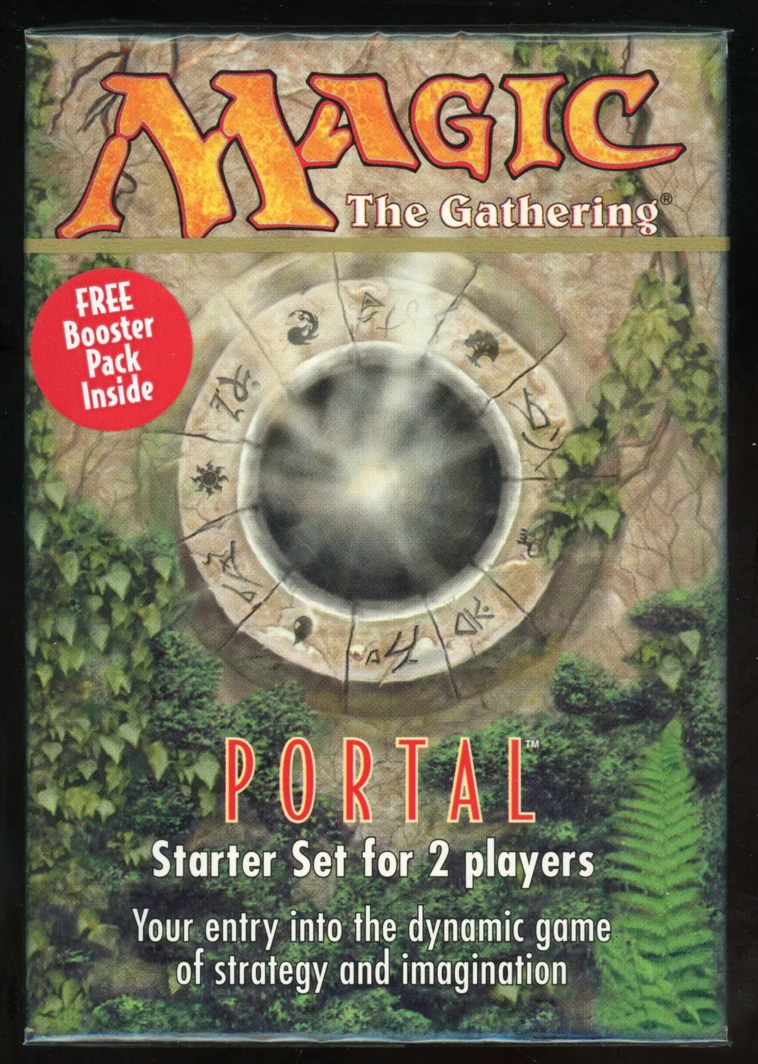
“I started playing M:tG in 1997 in fifth grade, long before current solutions existed. I remember going to large-scale events and crowding around an easel with printed lists of pairings before each round.”
- MAT BAKARICH, local Magic player

Slide 7
What other options are there for tournaments?
melee.gg and challonge are two browser-based tournament organization and pairings software solutions. They are useful for many types of tournaments but EventLink and the Companion App are specific to M:tG and are tailor-made for the specific game.

Slide 8
02
Summary of Findings

Slide 9
History
Magic: the Gathering has had tournaments since the mid 1990s, but only in recent years has organization gone digital. Registration, pairings, seating, and tournament math and standings were all done manually. By the 2000s, Tournament Organizers (TOs), were able to print list of player pairings and post them manually. In the 2010s, organizers gained the ability to transmit the pairings digitally to a monitor display somewhere visible to players. The Companion App was initially released in 2020, and has continued to be updated with new features like the Event Locator since then.

Slide 10
Current Software Solutions
Existing options for tournament organization do not currently feature a way to display a map with a seating location displayed to the individual player. Existing software solutions have many of the same current features as EventLink and Companion App. Other options like melee or challonge operate fully in-browser and do not have companion applications for the tournament entrant. The Companion App currently uses location data for the Event Locator to help players find local events to join.

Slide 11
The Future
Tournament rounds are timed, but any delays add to the length of the tournament. By adding this feature to the M:tG tournament software, we can improve user experience through easier access to information and through time-saving logistics. The sooner players know where they are seated for a round, the sooner the round can begin and complete, and the sooner the next one can begin. These events average about 1 hr per round of competition, an efficiently organized event can be a great time, but a poorly organized one can drag on for many extra hours. Prevent upset players and staff by keeping events manageable. The standard time allotted to find your seat at the start of a round is 10 minutes, by getting information to players sooner, we can cut this time by half.

Slide 12
03
Real-World Applications

Slide 13
OTHER APPLICATIONS:
Real-world possibilities for use cases for a player seating map.
CHESS
FIGHTING GAMES
When played in-person and not online, Chess is a great example of a tournament setting where a player seating map would be advantageous to both event organizers and competitors.
Many fighting video games like Super Smash Bros or the Tekken Series have active tournament communities. These events are held live in-person and sometimes at large scales like in a convention hall.
SPORTS TOURNAMENTS
CONVENTIONS
We have the possibility to explore other applications for this software other than just tournaments. It could be adapted for use for displaying booth locations and meeting times to convention attendees.
Similar technology could be used to display which field a sports team meets on and where it is located in a park or sports complex relative to other fields.

Slide 14

In addition to use in the M:tG EventLink and Companion App, a player seating map could be used for other types of tournaments.

Slide 15
04
Design Approach

Slide 16
DESIGN APPROACH
Key elements of project development planning.
EFFECTIVE
FEEDBACK
If the software solution does not work well, it will not be adopted for wider use by the Magic: the Gathering tournament community. In order to be effective, the software should be fast and easy to use.
Input from TOs and players is key, we have surveyed organizers and players to ensure this feature is implemented smoothly and effectively. Further feedback will be gathered to ensure timely updates and improvements can be made.
CONVENIENT
EASE OF USE
Use of this feature must be easy and intuitive. Enabling the feature should be a convenience for both players and organizers.
Someone who has never used any tournament software before should be able to configure the seating map option easily. The instructions will be straightforward and intuitive with visual examples.

Slide 17
05
Design Proposal

Slide 18
Improving the M:tG Companion App and EventLink Software
Goal: Improve user experience by adding a seating layout map that is created in EventLink and transmitted to the Companion App. Improve tournament logistics by helping entrants find their seats in record time.

Slide 19
Create a Seating Layout
During Event Creation
-Tournament Organizers will have the ability to create a seating layout map of all the table locations at the venue and add table numbers.
-This map will be sent to players using the Companion App alongside the round pairings each round.

Slide 20
Save Layouts Easily for Future Use.
Tournament organizers will simply check a box during the event creation process to be taken to a menu to use a saved layout or create a new one. The process of creating and saving a new layout is simple and straightforward.

Slide 21
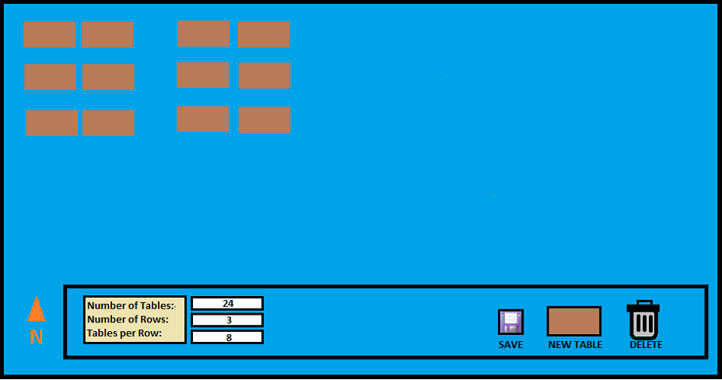
01
Background
Tournament Organizers will be presented with a menu and graphical interface like this one where they can input values for table calculations or manually add and remove individual tables.

Slide 22
Players don’t need to do anything!
If this feature is setup and enabled by the tournament organizer, a third tab will be created in the Companion App menu where players can see the location of their table for the round. By locating it adjacent to the “Pairings” tab, players will have quick and easy access.

Slide 23
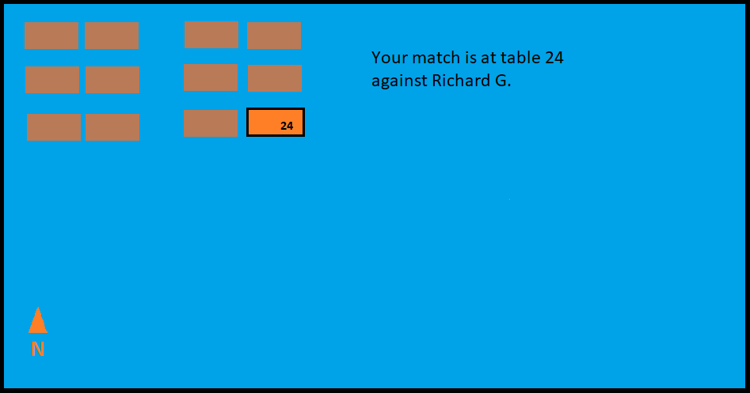
01
Background
Players will be displayed a map similar to the one shown here. Whether the event is at a small comic book shop or a large convention center, players will be able to find their seat quickly and easily.
This helps ensure that events run smoothly for both players and organizers.

Slide 24
06
Open Questions

Slide 25

You are Here.
The Companion App already has event locating capabilities, why does it not include a feature to help players find their seat at an event?
Why hasn’t this technology been implemented already?

Slide 26
Quality of Life
What other changes or improvements can be made to the software to improve the user experience for both players and tournament organizers?

Slide 27
Broader Scope
Once developed and implemented, how can we take the features available in the EventLink software and Companion App and apply them to broader use cases? Instead of an app specific to M:tG, what other industries and applications can benefit from this?

Slide 28
07
Citations

Slide 29
M:tG Portal image source:
https://www.ebay.com/itm/276719486282?chn=ps&norover=1&mkevt=1&mkrid=711-117182-37290-0&mkcid=2&mkscid=101&itemid=276719486282&targetid=2299003535955&device=c&mktype=pla&googleloc=9030236&poi=&campaignid=21214315381&mkgroupid=161363866036&rlsatarget=pla-2299003535955&abcId=9407526&merchantid=115289845&gad_source=1&gclid=Cj0KCQiAx9q6BhCDARIsACwUxu72ouPOP4sYUchkqfhhl6qpPoKIleQxwh4RDgAZaaADGYpF3h9zL6IaAqryEALw_wcB
Chess Pawn image source:
https://www.istockphoto.com/photos/chess-pawn
You are Here image source:
https://www.istockphoto.com/photos/you-are-here-sign
Save Icon image source:
Copy and paste from MS paint.

Slide 30
The following sources were used for research but are not directly cited in the presentation:
Pima Library Search:
https://www.proquest.com/docview/1728217139?pq-origsite=summon&accountid=13194&sourcetype=Wire%20Feeds
https://www.proquest.com/docview/1898415708?pq-origsite=summon&accountid=13194&sourcetype=Wire%20Feeds
Other Websites:
Melee.gg:
https://melee.gg/
Challonge.com:
https://challonge.com/
Wizards of the Coast:
https://wpn.wizards.com/en/news/definitive-guide-wizards-eventlink
Background

